Slide 1
HOW GEOGRAPHY IMPACTS LIFESTYLE AND MEDIA USAGE ON THE PRAIRIES
STUDY OBJECTIVES:
To determine what impact ‘community’ has on the types of news and information that people are interested in and the sources they use to seek out that information.
To identify influences and factors that could play a role in how people in different types of communities access information.
Use the information to quantify the differences between populations living in rural areas and smaller communities against those living in larger cities and metropolitan areas.
How does media accessibility influence the sources people use to get information.

Slide 2
THE STUDY
Commissioned by AdWest Marketing Inc and conducted by Totum Research Inc.
Survey: 8-Page Mailed Questionnaire. Sample was selected by SM Research split into 1,000 random addresses within each of the 5 geographic groups for a total of 5,000 addresses in Alberta, Saskatchewan, Manitoba and Northwest Territories/Nunavut
Communities: Under 5,000 Population and Rural
Communities: 5,000 to 10,000 Population
Communities: 10,000 to 50,000 Population
Communities: 50,000 to 100,000 Population
Communities: Over 100,000 Population
Surveys addressed to the resident of the household 18 years of age or older and the next to celebrate a birthday in the household.
Timing: Mid November 2013 – Mid January 2014

Slide 3
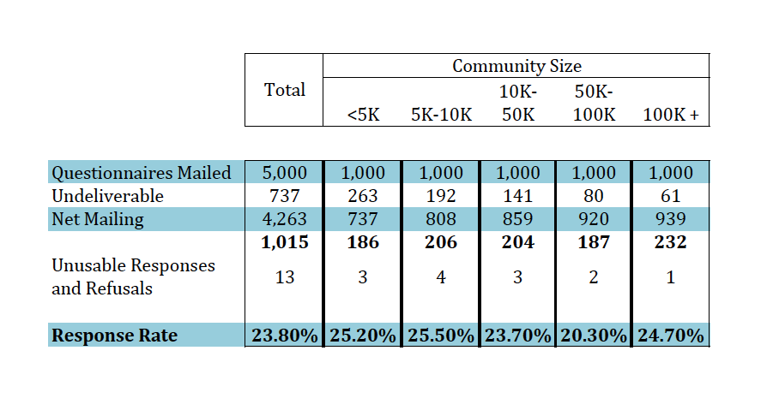
Sample sizes and response rates
The maximum margin of error for 1,015 responses is ±3.1% at the 95% confidence level. For 200 responses it is ±6.9% at the 95% confidence level.

Slide 4
2013 AdWest Study of Media Usage by Community Size and Type
TOTUM RESEARCH - Media Usage by Community Size and Type, Nov/Dec 2013

Slide 5
Time Spent With News Compared to 2 Years Ago
TOTUM RESEARCH - Media Usage by Community Size and Type, Nov/Dec 2013

Slide 6
Amount of Time Personally Spent with Community Newspaper Compared to 2 Years Ago by Community Size
TOTUM RESEARCH - Media Usage by Community Size and Type, Nov/Dec 2013

Slide 7
Types of News Followed 'Most of the Time' by Community Size
TOTUM RESEARCH - Media Usage by Community Size and Type, Nov/Dec 2013

Slide 8
Length of Time Lived in Your Community by Community Size
TOTUM RESEARCH - Media Usage by Community Size and Type, Nov/Dec 2013

Slide 9
Incidence of Knowing the Names of Neighbours Who Live Close By
TOTUM RESEARCH - Media Usage by Community Size and Type, Nov/Dec 2013

Slide 10
Media Used to Consume Local News and Information at Least Once Per Week by Community Size
TOTUM RESEARCH - Media Usage by Community Size and Type, Nov/Dec 2013

Slide 11
Favourite Source for Local News by Community Size
TOTUM RESEARCH - Media Usage by Community Size and Type, Nov/Dec 2013

Slide 12
How Well Does Favourite Local News Source Give you the Information you Need by Community Size: NET ALL OR MOST
TOTUM RESEARCH - Media Usage by Community Size and Type, Nov/Dec 2013

Slide 13
Topics of Local Interest by Community Size: Respondent Indicated a Source Was Sought for Each Topic
TOTUM RESEARCH - Media Usage by Community Size and Type, Nov/Dec 2013

Slide 14
Favourite Source for Information by Topic of Interest and Community Size
In Communities of Less than 50K, the Local Printed Community Newspaper Was Given as the Favourite Source for Local Information Across ALL Topics. Respondents in All Community Sizes Indicate that a Traditional Media Was the Favourite Source for Information on all Topics Sourced.
 | Communities Under 5,000 Population | Communities 5K-10K | Communities 10K-50K | Communities 50K -100K | Communities 50K+
Local Restaurants, Bars and Clubs | Printed Local Community Newspaper | Printed Local Community Newspaper | Printed Local Community Newspaper | Radio | Daily Newspaper or its Website
Other Local Businesses | Printed Local Community Newspaper | Printed Local Community Newspaper | Printed Local Community Newspaper | Printed Local Community Newspaper | Daily Newspaper or its Website
Community or Neighbourhood Events | Printed Local Community Newspaper | Printed Local Community Newspaper | Printed Local Community Newspaper | Printed Local Community Newspaper | Printed Local Community Newspaper
Local Weather | TV | TV | TV | TV | TV
Local Arts and Culture | Printed Local Community Newspaper | Printed Local Community Newspaper | Printed Local Community Newspaper | Radio | Daily Newspaper or its Website
Local Breaking News | TV | Radio | Radio | Radio | TV
Local Job Openings | Printed Local Community Newspaper | Printed Local Community Newspaper | Printed Local Community Newspaper | Daily Newspaper or its Website | Daily Newspaper or its Website
Local Traffic or Transportation | TV | Radio | Radio | Radio | Radio
Local Housing and Real Estate | Printed Local Community Newspaper | Printed Local Community Newspaper | Printed Local Community Newspaper | Printed Local Community Newspaper | Daily Newspaper or its Website
Local Schools and Education | Printed Local Community Newspaper | Printed Local Community Newspaper | Printed Local Community Newspaper | Daily Newspaper or its Website | Printed Local Community Newspaper
Local Crime | Printed Local Community Newspaper | Printed Local Community Newspaper | Printed Local Community Newspaper | Radio | Television

Slide 15
Impact That Not Having a Local Community Newspaper Would Have on Your Ability to Keep up With Information About Your Community
TOTUM RESEARCH - Media Usage by Community Size and Type, Nov/Dec 2013

Slide 16
Media Engagement, Sharing and Response: COMMUNITIES > 5K
TOTUM RESEARCH - Media Usage by Community Size and Type, Nov/Dec 2013

Slide 17
Media Engagement, Sharing and Response: COMMUNITIES 5-10K
TOTUM RESEARCH - Media Usage by Community Size and Type, Nov/Dec 2013

Slide 18
Media Engagement, Sharing and Response: COMMUNITIES 10-50K
TOTUM RESEARCH - Media Usage by Community Size and Type, Nov/Dec 2013

Slide 19
Media Engagement, Sharing and Response: COMMUNITIES 50-100K
TOTUM RESEARCH - Media Usage by Community Size and Type, Nov/Dec 2013

Slide 20
Media Engagement, Sharing and Response: COMMUNITIES 100K+
TOTUM RESEARCH - Media Usage by Community Size and Type, Nov/Dec 2013

Slide 21
Internet Connectivity by Community Size
TOTUM RESEARCH - Media Usage by Community Size and Type, Nov/Dec 2013

Slide 22
OF OWNERS: Uses of Mobile Device/Tablet Computer by Community Size
TOTUM RESEARCH - Media Usage by Community Size and Type, Nov/Dec 2013

Slide 23
Activities Taken in the Past 30 Days as a Result of Seeing an Advertisement on a Website
TOTUM RESEARCH - Media Usage by Community Size and Type, Nov/Dec 2013

Slide 24
Use 'Apps' to Help Get Information About Your Local Community on a Cell Phone or Tablet Computer
TOTUM RESEARCH - Media Usage by Community Size and Type, Nov/Dec 2013

Slide 25
Incidence of Paying to Get Local News/Information Online
TOTUM RESEARCH - Media Usage by Community Size and Type, Nov/Dec 2013

